Slide 1


DSO ENTITY
Key challenges for demand response & congestion management:
The best way to involve stakeholders
Torsten Knop

Slide 2
DSOs as Market Facilitators for Local Services: Local by Nature, European by Impact
Local ≠ System-Wide
Local grid challenges differ fundamentally from system-wide: highly locational and time-specific
Distribution-level constraints
Optimized combination of tools, considering the specific requirements of different network types.
National Terms & Conditions
National Terms & Conditions are the important for implementing the NCDR
Markets for local services
Tailoring to specificities and capabilities of SO including involvement and commitment of all stakeholders
Local flexibility markets
FCA
Rules-based
Implicit Flexibility
Allows all grid users to provide flexibility on a competitive and non-discriminatory way
Provide new and existing customers with an option where the full capacity is not available
Complementary to other mechanisms rules-based approaches can provide solutions
Incentivize a certain customer behavior and unlock the potential of implicit flexibility

Slide 3
DSO Entity key recommendations
Commitment by NRA
for swift approval
R2: Define and publish a transparent roadmap to implement local markets
R10: Establish efficient TSO–DSO and DSO–DSO coordination through jointly defined proposals
R11: Develop proportional, standardised and interoperable data, ICT and (near-)real-time communication requirements for local flexibility services
R9: Ensure physical delivery of flexibility to the grid
R8: Establish Flexibility Information System (FIS) modules by building on existing infrastructures
R5: Secure the flexibility value from end-to-end
R1: Start now and embrace the opportunities and challenges that come with the use of flexibility services
R3: Engage Stakeholders in the implementation process and jointly manage change
R6: Procure local services and operate markets where efficient
R4: Promote opportunities for customers to become flexible to develop the needed liquidity for local markets
R7: Develop tailored (yet standardised) local flexibility products, markets rules and processes
3

Slide 4

DSO must engage early and align with relevant stakeholders
Structured and transparent implementation roadmap:
    All parties can work collaboratively
    Closing identified gaps, implementing and scaling up flexibility while making best use of test and learn
In addition, DSO should provide service providers short- and long-term visibility about opportunities in the local market.
Acknowledge that things will not be perfect immediately:
    Rules, technical and economic aspects
Accept to overcome these difficulties by:
    Common understanding of the impact of the gaps, shared trust and joint objectives
Require a commitment from NRA to swiftly approve regulatory changes when gaps are identified.

Slide 5
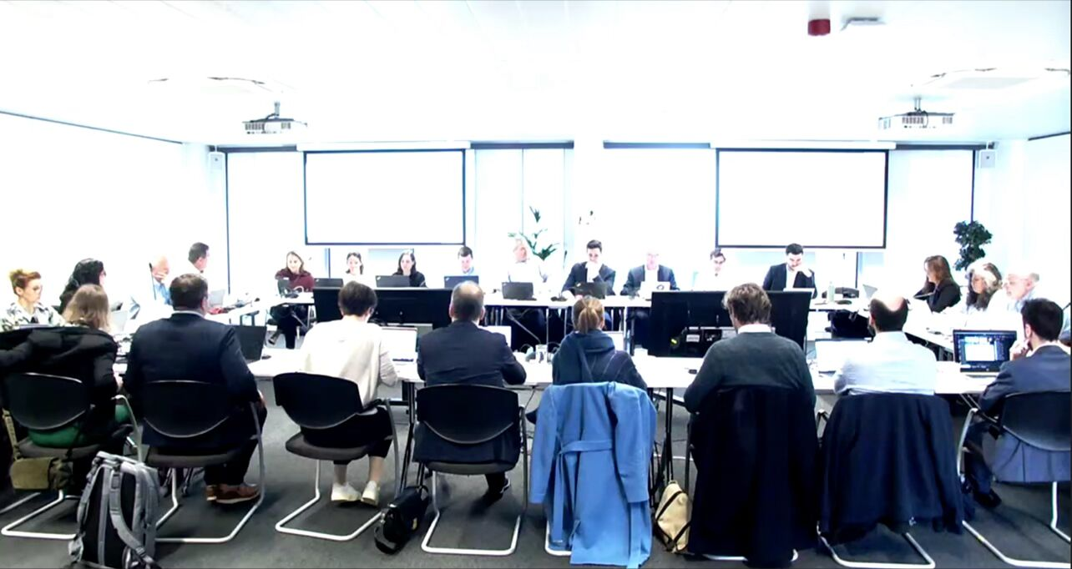
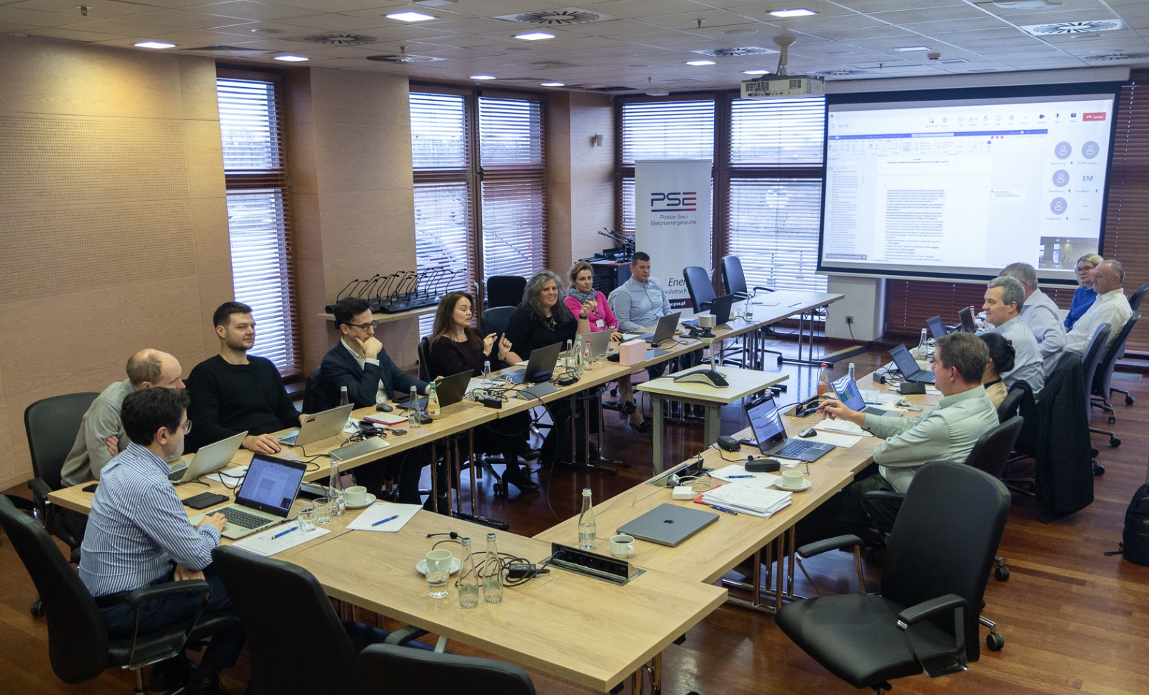

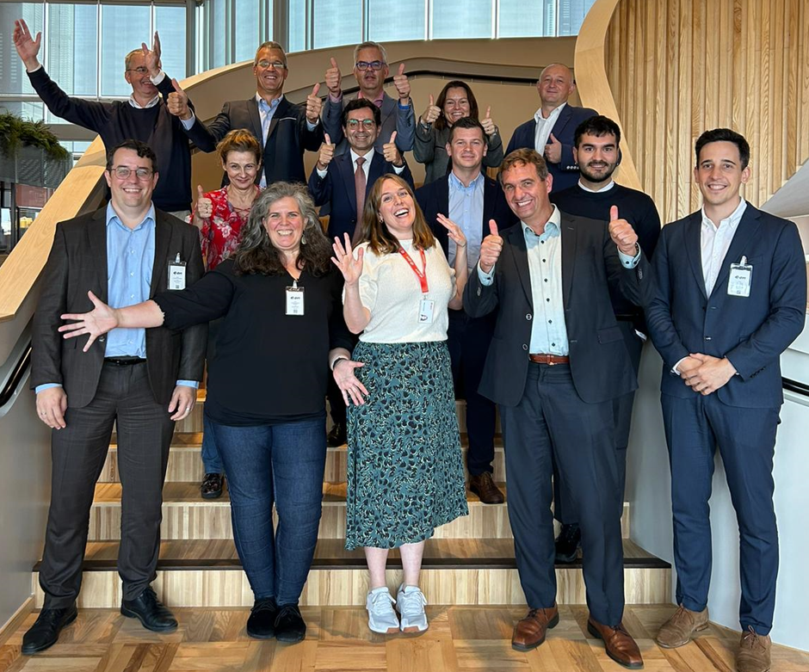











Stakeholder engagement – Drafting Committee and beyond
DSO Entity and ENTSO-E convened a Drafting Committee to support the NCDR development process.
The Drafting Committee members:
  Received information in a timely and transparent way about the Development Team.
  Identified focus topics for in-depth discussion in the Drafting Committee.
  Had access to the NCDR draft released by the Development Team every month.
However, stakeholders’ engagement was broader by:
  Repeated consultations on relevant drafts of the Network Code
  Multiple ad hoc engagement with stakeholders on specific topics.
400+ meetings involving over 200+ experts
Stakeholders encourage similar process
in the future
5

